Slide 1

Laboratory & Professional skills for Bioscientists Term 2: Data Analysis in R
Correlation and Regression

Slide 2
Summary of this week
Situations where our explanatory variable is ‘continuous’ rather than categorical.
Parametric and non-parametric correlation
Meaning
Assumptions
Carrying out, interpreting and Reporting
Tests of correlation coefficients
Regression
Meaning and terminology
Carrying out, interpreting and Reporting
Assumptions
Assessment of fit (explanatory power)
Notes:
Continuous or ordered discrete

Slide 3
Learning objectives for the week
By actively following the lecture and practical and carrying out the independent study the successful student will be able to:
Explain the principles of correlation and of regression (MLO 1)
Apply (appropriately), interpret and evaluate the legitimacy of, both in R (MLO 2, 3 and 4)
Summarise and illustrate with appropriate R figures test results scientifically (MLO 3 and 4)

Slide 4
Correlation and Regression Similar but different
Similar
Linear
Two continuous/ordered variables
Illustrated with a scatter plot
Different
Correlation is association; regression is prediction
In correlation axes can be switched; in regression axis cannot be switched
Do not put a line of best fit on a correlation graph; regression graph must have the regression line

Slide 5
Correlation and Regression Similar but different
Correlation
Linear association
No cause and effect
Axes could be swapped
Regression
Linear relationship
Cause and effect
Axes cannot be swapped

Slide 6
Correlation Basics
Pearson’s (Pearson’s Product Moment Correlation Coefficient)
Parametric
Sample correlation: r
Reflects degree of linear association between two sampled variables: -1 to +1

Slide 7
Correlation Example of correlations
r ≈ 1
r ≈ -1
Positive: Highest scores on one axis associated with highest scores on other
Negative: Highest scores on one axis associated with lowest scores on other

Slide 8
Correlation Example of positive correlations
r ≈ 1
Highest scores on one axis associated with highest scores on other

Slide 9
Correlation Correlation but not linear
r ≈ 0
Cannot use Pearson’s PMMC

Slide 10
Correlation Example
Wheat seeds: High quality visualization of the internal kernel structure by a soft X-ray technique and 7 measurements taken:
Area.
Perimeter.
Compactness
Length of kernel.
Width of kernel.
Asymmetry coefficient.
Length of kernel groove.

Slide 11
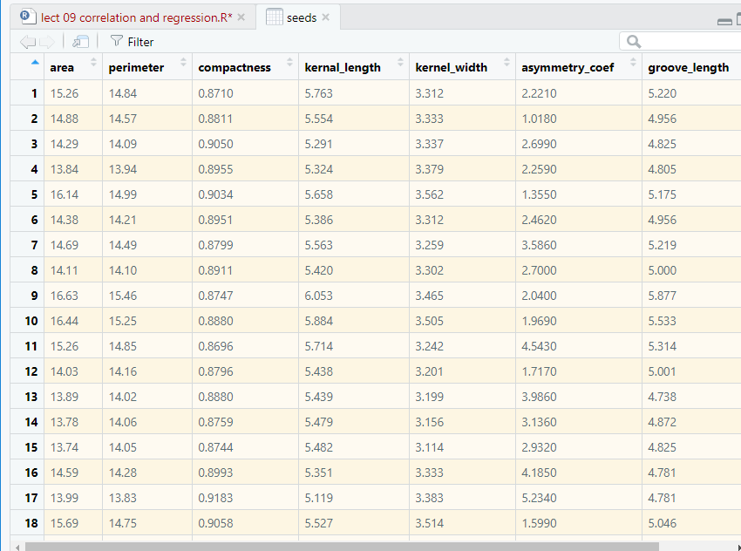
Correlation Example

Slide 12
Two-way ANOVA example Reading in and examining the structure of the data
library(readxl)
file <- "../data/seeds_dataset.xlsx"
seeds <- read_excel(file, sheet = "seeds_dataset")
glimpse(seeds)
Observations: 70
Variables: 7
$ area <dbl> 15.26, 14.88, 14.29, 13.84, 16.14, 14.38, 14.69, 14.11, 1...
$ perimeter <dbl> 14.84, 14.57, 14.09, 13.94, 14.99, 14.21, 14.49, 14.10, 1...
$ compactness <dbl> 0.8710, 0.8811, 0.9050, 0.8955, 0.9034, 0.8951, 0.8799, 0...
$ kernal_length <dbl> 5.763, 5.554, 5.291, 5.324, 5.658, 5.386, 5.563, 5.420, 6...
$ kernel_width <dbl> 3.312, 3.333, 3.337, 3.379, 3.562, 3.312, 3.259, 3.302, 3...
$ asymmetry_coef <dbl> 2.2210, 1.0180, 2.6990, 2.2590, 1.3550, 2.4620, 3.5860, 2...
$ groove_length <dbl> 5.220, 4.956, 4.825, 4.805, 5.175, 4.956, 5.219, 5.000, 5...
Assumptions: “bivariate normal”
Common sense

Slide 13
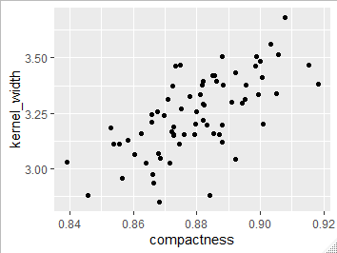
Correlation Plot your data
Plot your data: roughly
ggplot(data = seeds, aes(x = compactness, y = kernel_width)) +
geom_point()
Check roughly linear
This looks ok

Slide 14
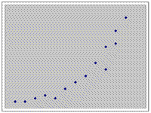
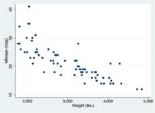
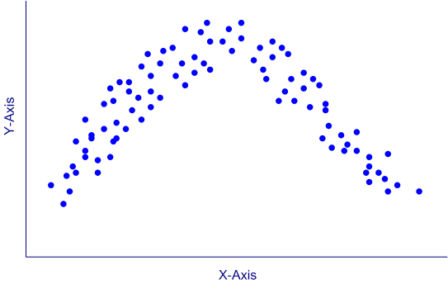
Correlation Plot your data
Not suitable for linear correlation

Slide 15
Correlation Running the test
cor.test(seeds$compactness, seeds$kernel_width)
Pearson's product-moment correlation
data: seeds$compactness and seeds$kernel_width
t = 7.3738, df = 68, p-value = 2.998e-10
alternative hypothesis: true correlation is not equal to 0
95 percent confidence interval:
0.5117537 0.7794620
sample estimates:
cor
0.6665731
Gives type of correlation
t-test of whether r is different from zero
Correlation coefficient, r

Slide 16
Correlation Reporting the result
data: seeds$compactness and seeds$kernel_width
t = 7.3738, df = 68, p-value = 2.998e-10
alternative hypothesis: true correlation is not equal to 0
95 percent confidence interval:
0.5117537 0.7794620
sample estimates:
cor
0.6665731
There is a significant positive correlation (r = 0.67) between compactness and kernel width (t = 7.37; d.f. = 68, p < 0.001).

Slide 17
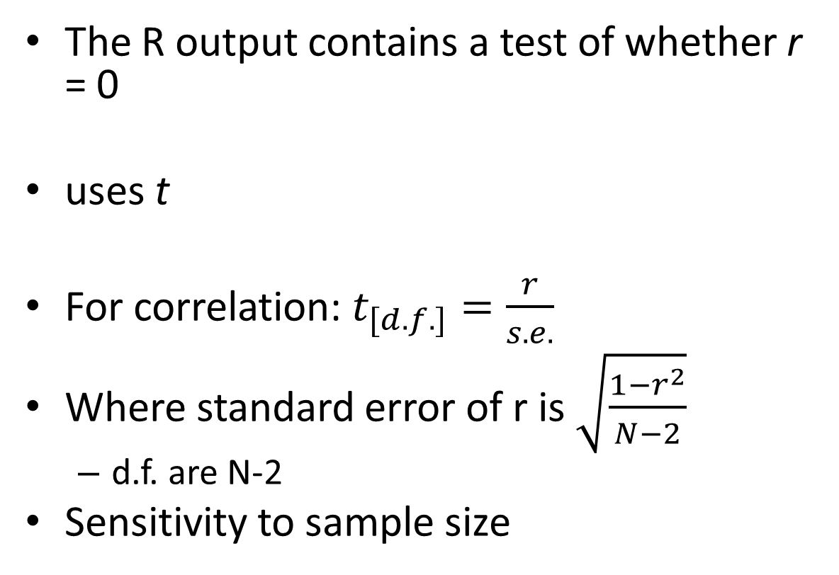
Correlation Understanding the test of significance
The R output contains a test of whether r = 0
uses t
For correlation: $t_{[d.f.]}=\frac{r}{s.e.}$
Where standard error of r is $\sqrt{\frac{1−r^{2}}{N−2}}$
d.f. are N-2
Sensitivity to sample size

Slide 18
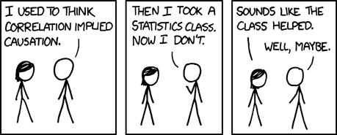

Slide 19
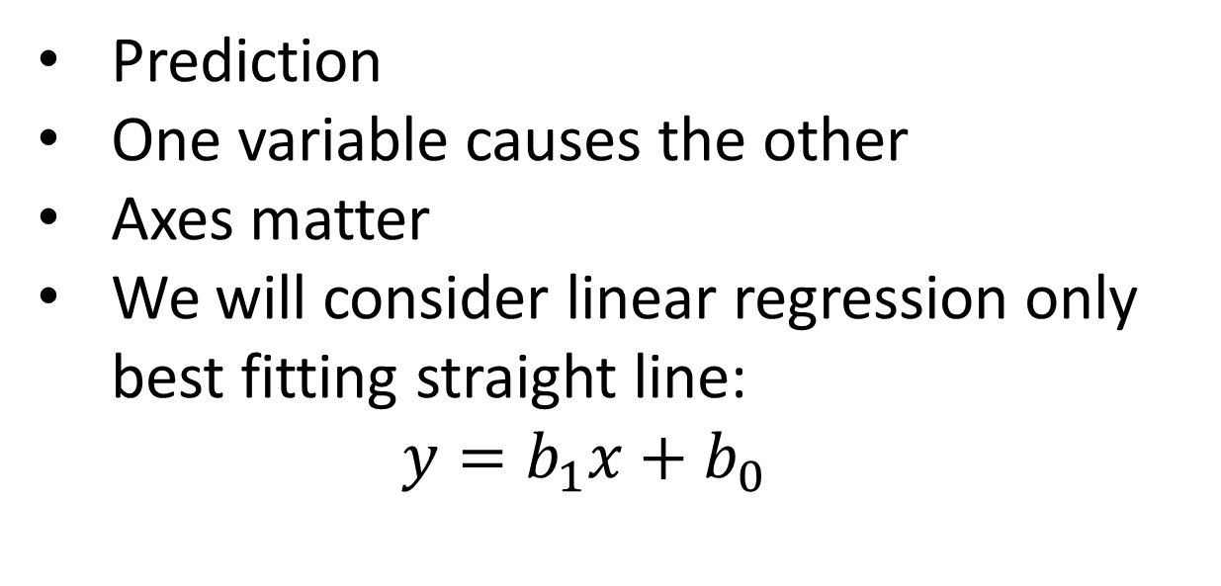
Regression
Prediction
One variable causes the other
Axes matter
We will consider linear regression only
best fitting straight line:
$$y=b_{1}x+b_{0}$$

Slide 20
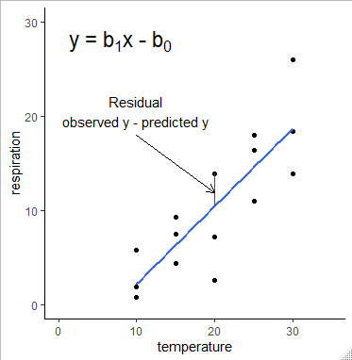
Regression The terminology
Notes:
ggplot(data = shrimp, aes(x = temperature, y = respiration)) +
geom_point() +
geom_smooth(method = "lm", se = FALSE) +
xlim(0, 35) +
ylim(0, 30) +
geom_segment(x = 20, y = 13.852,
xend = 20, yend = 10.469200,
colour = "red") +
geom_segment(x = 10, y = 18,
xend = 20, yend = 11.9,
arrow = arrow(length = unit(0.1, "inches")),
colour = "black") +
annotate("text", x = 10, y = 20.5, label = "Residual\nobserved y - predicted y") +
annotate("text", x = 8, y = 28,
label = expression("y = b"[1]*"x - b"[0]),
size = 6) +
theme_classic()

Slide 21
Regression Null hypothesis
Can be expressed as:
b₁ = 0
x cannot predict y
Regression line doesn’t explain variance in y
Assumptions
Normality and homoscedascity of residuals
y values are independent
x is measured is chosen/set

Slide 22
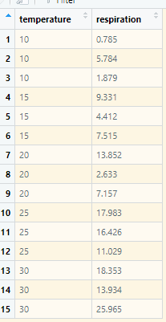
Regression Example
Brine Shrimp (Artemia salina) were put in water baths at 10C, 15C, 20C, 25C, 30C and their respiration rate measured (units)
Assumptions
Normality and homoscedascity of residuals
y values are independent
x is measured is chosen/set

Slide 23
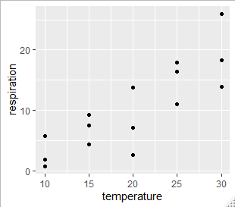
Correlation Plot your data
Plot your data: roughly
ggplot(data = shrimp, aes(x = temperature, y = respiration)) +
geom_point()
Check roughly linear
This looks ok

Slide 24
Regression Running the test
mod <- lm(data = shrimp,
respiration ~ temperature)
summary(mod)

Slide 25
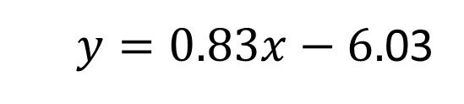
Regression Understanding the output
Core statistical ideas – very extendable. You will see again next year
Call:
lm(formula = respiration ~ temperature, data = shrimp)
Residuals:
Min 1Q Median 3Q Max
-7.8362 -2.6216 -0.3377 3.1854 7.2433
Coefficients:
Estimate Std. Error t value Pr(>|t|)
(Intercept) -6.0359 3.1560 -1.912 0.0781 .
temperature 0.8253 0.1488 5.547 9.43e-05 ***
---
Signif. codes: 0 ‘***’ 0.001 ‘**’ 0.01 ‘*’ 0.05 ‘.’ 0.1 ‘ ’ 1
Residual standard error: 4.074 on 13 degrees of freedom
Multiple R-squared: 0.703, Adjusted R-squared: 0.6801
F-statistic: 30.77 on 1 and 13 DF, p-value: 9.433e-05
b₀ and b₁
$y=0.83x−6.$03

Slide 26
Regression Understanding the output
Call:
lm(formula = respiration ~ temperature, data = shrimp)
Residuals:
Min 1Q Median 3Q Max
-7.8362 -2.6216 -0.3377 3.1854 7.2433
Coefficients:
Estimate Std. Error t value Pr(>|t|)
(Intercept) -6.0359 3.1560 -1.912 0.0781 .
temperature 0.8253 0.1488 5.547 9.43e-05 ***
---
Signif. codes: 0 ‘***’ 0.001 ‘**’ 0.01 ‘*’ 0.05 ‘.’ 0.1 ‘ ’ 1
Residual standard error: 4.074 on 13 degrees of freedom
Multiple R-squared: 0.703, Adjusted R-squared: 0.6801
F-statistic: 30.77 on 1 and 13 DF, p-value: 9.433e-05
Test: b₀ = 0
Often not impt
Test: b₁ = 0
Always of interest
Test of ‘model’
Same as b₁ = 0
in single regression
Multiple R-squared: Proportion of y explained by x

Slide 27
Regression Reporting the results
Coefficients:
Estimate Std. Error t value Pr(>|t|)
(Intercept) -6.0359 3.1560 -1.912 0.0781 .
temperature 0.8253 0.1488 5.547 9.43e-05 ***
---
Signif. codes: 0 ‘***’ 0.001 ‘**’ 0.01 ‘*’ 0.05 ‘.’ 0.1 ‘ ’ 1
Residual standard error: 4.074 on 13 degrees of freedom
Multiple R-squared: 0.703, Adjusted R-squared: 0.6801
F-statistic: 30.77 on 1 and 13 DF, p-value: 9.433e-05
Reporting the result: “significance, direction, magnitude”
The temperature explained a significant amount of the variation in respiration rate (ANOVA: F = 30.8; d.f. = 1, 13; p < 0.001). The regression line is: Respiration rate= 0.83 * temperature - 6.04
Notes:
Remember to quote two sets of df for each F

Slide 28
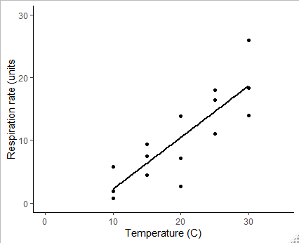
Regression Reporting the results: figure
Notes:
ggplot(data = shrimp, aes(x = temperature, y = respiration)) +
geom_point() +
geom_smooth(method = "lm", se = FALSE, colour = "black") +
xlim(0, 35) +
ylim(0, 30) +
ylab("Respiration rate (units") +
xlab("Temperature (C)") +
theme_classic()

Slide 29
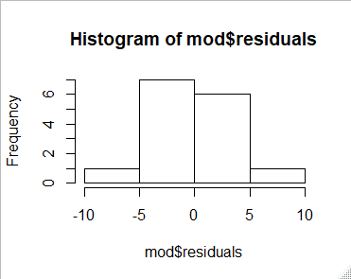
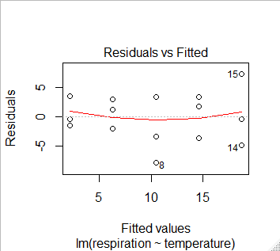
Regression Checking Assumptions
Residuals are calculated for you already!
Histogram of residuals should be normally distributed
hist(mod$residuals)
shapiro.test(mod$residuals)
Shapiro-Wilk normality test
data: (mod$residuals)
W = 0.97969, p-value = 0.9673
plot(mod, which = 1)
Spread of residuals should be similar in each group

Slide 30
Correlation and Regression Summary of reporting
Correlation - association
quote r, its significance (p) and n
if scatterplot included do NOT show a fitted line
Regression - relationship
quote regression equation and test result (either ANOVA or t)
may also quote r² but not r
if scatterplot included do show a fitted line

Slide 31
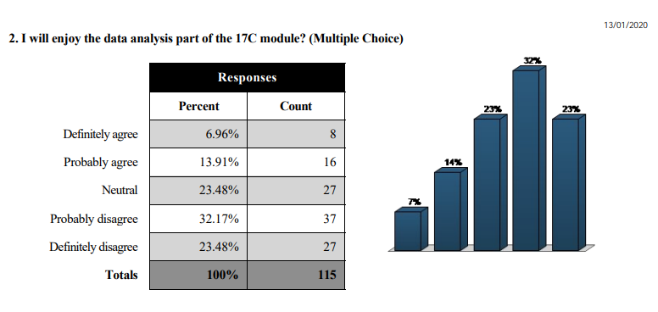

Slide 32
Learning objectives for the week
By actively following the lecture and practical and carrying out the independent study the successful student will be able to:
Explain the principles of correlation and of regression (MLO 1)
Apply (appropriately), interpret and evaluate the legitimacy of, both in R (MLO 2, 3 and 4)
Summarise and illustrate with appropriate R figures test results scientifically (MLO 3 and 4)

